Slide 1
ASSIGNMENT
CHAPTER # 1
CHAPTER # 1 “Topics”
1) Nested Quantifiers
2) Normal form
2.1 Conjunction NF
2.2 Disjunction NF
3)Resolution Principal
4) Rules of Inference "For Quantified Statements"

Slide 2
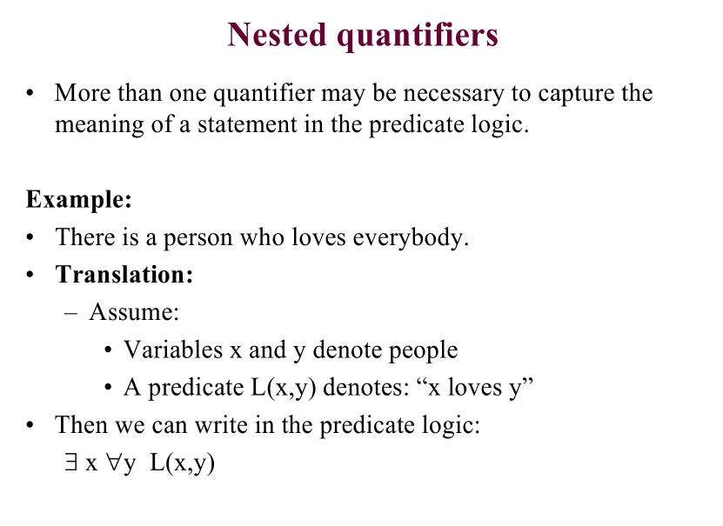

Slide 3
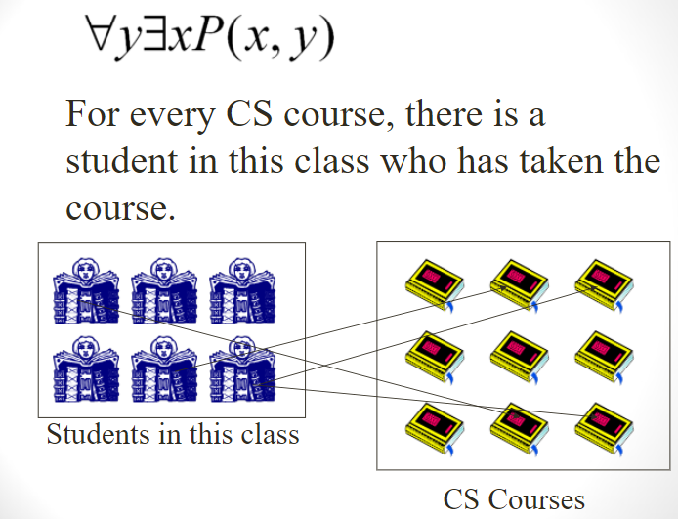

Slide 4
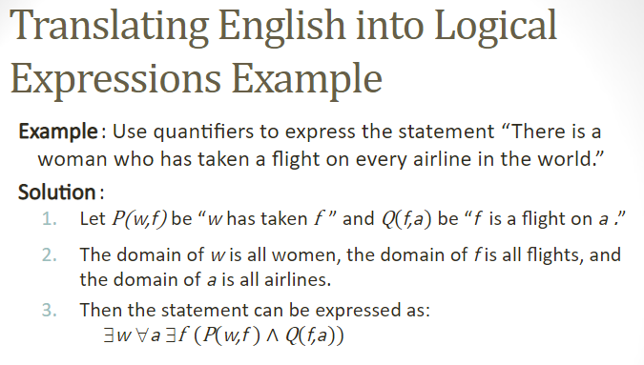

Slide 5
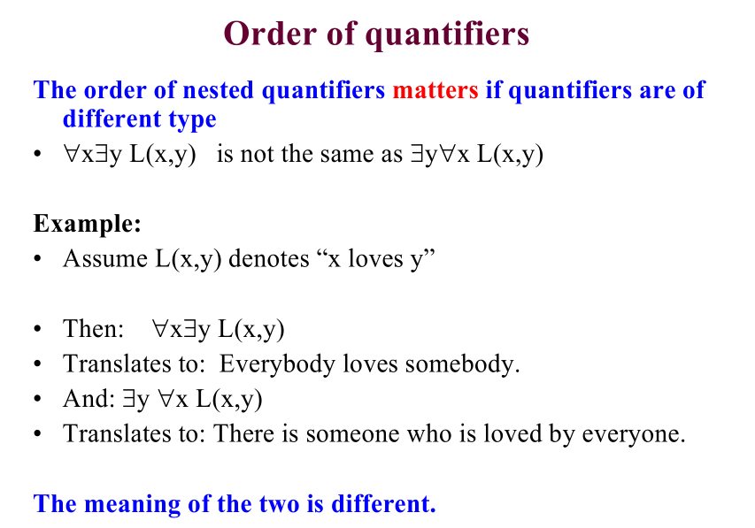

Slide 6
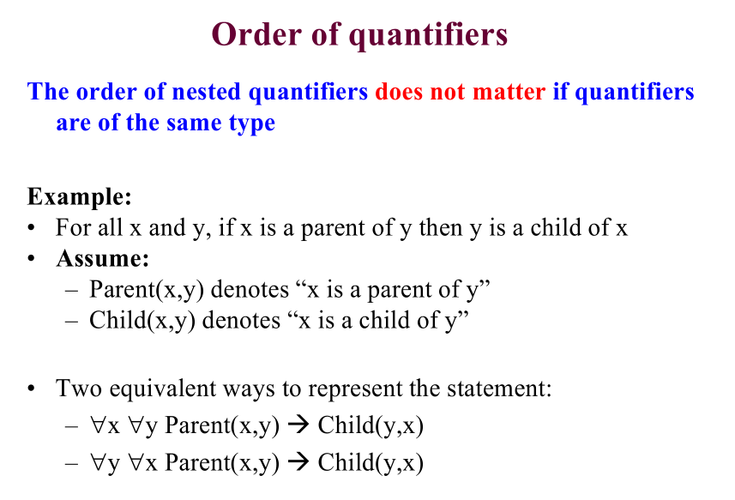

Slide 7
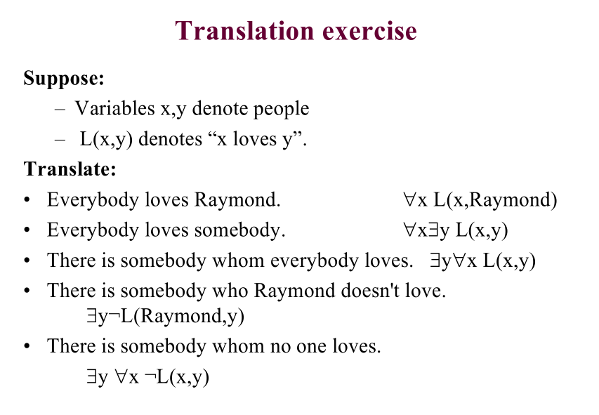

Slide 8
EXERCISE:
Translate this sentence into a logical expressions.
“If a person is female and is a parent, then she is someone’s mother.”
F(x) is “x is female”,
P(x) is “x is someone’s parent”,
M(x,y), “x is the mother of y”

Slide 9
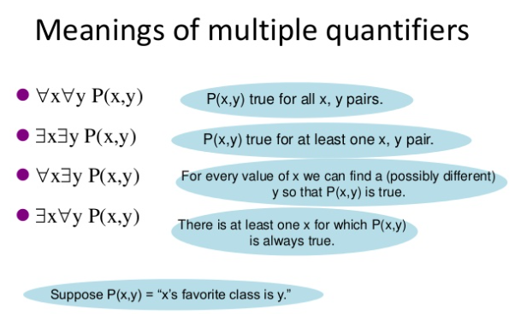

Slide 10
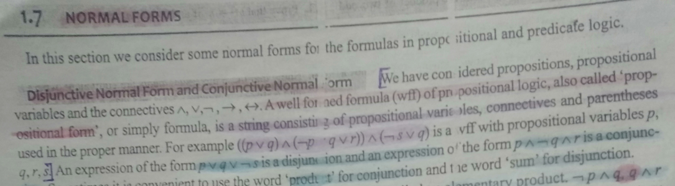
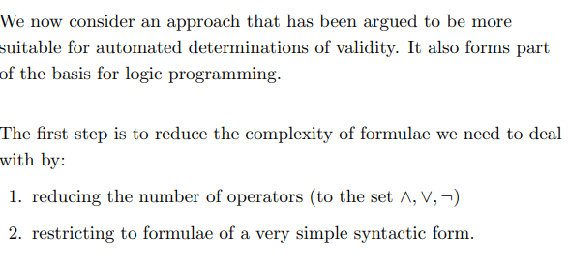

Slide 11
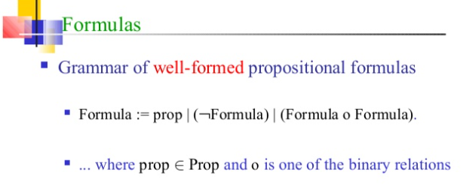

Slide 12
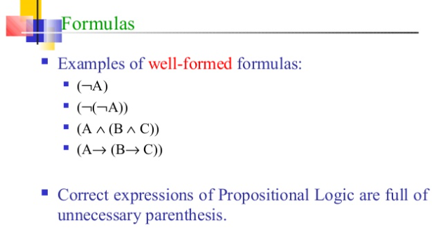

Slide 13
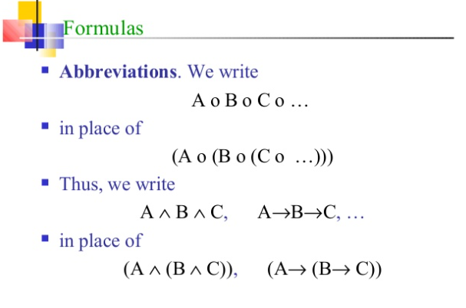

Slide 14
Literals
A literal is either an atomic proposition or the negation of an atomic proposition, i.e., for all propositional variables P, P and ¬P are literals.
P is a positive literal, ¬P is a negative literal

Slide 15
Clauses
A clause is the disjunction of literals.
Example: B∨¬C∨¬D, Being ∨ ¬Being, ...
A unit clause is a clause that contains only a single literal.
Example: B,¬C are unit clauses, B ∨ ¬C isn’t
A empty clause does not contain literals

Slide 16
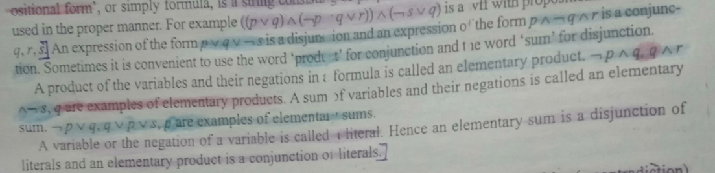
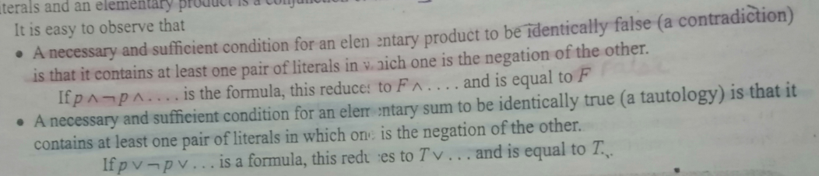

Slide 17
Conjunctive Normal Form (CNF)
A proposition is in conjunctive normal form (CNF) if it is a (finite) conjunction of clauses.
Examples: (A∨¬B) ∧ (B ∨¬C ∨¬D), ¬A ∧ B, A ∧ (B ∨ C ∨¬D), ...

Slide 18
Conversion to CNF
The algorithm implementing the conversion to a CNF is based on the tautologies about logical equivalence (or double implication): - double-negation law (i.e. elimination of ¬¬) - De Morgan’s laws - distributive laws - elimination of → and ↔ (see the next slide)

Slide 19
Conversion to CNF Basic Tautologies
¬(¬α) = α double-negation elimination
¬(α ∧ β) = (¬α ∨¬β) De Morgan’s Law for ∧
¬(α ∨ β) = (¬α ∧¬β) De Morgan’s Law for ∨
(α ∧ (β ∨ γ)) = ((α ∧ β) ∨ (α ∧ γ)) distributivity of ∧ over ∨
(α ∨ (β ∧ γ)) = ((α ∨ β) ∧ (α ∨ γ)) distributivity of ∨ over ∧
(α →β)= (¬α ∨ β) →-elimination
(α ↔β)=((α →β)∧(β →α)) ↔-elimination

Slide 20
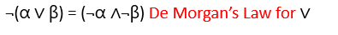
Example # 01 Conversion to CNF of A↔(B∨C)
Eliminate ↔: (A→(B ∨C)) ∧ ((B ∨C) →A)
Eliminate →: (¬A∨B ∨C) ∧ (¬(B ∨C) ∨A)
Move ¬ inwards using de Morgan’s laws: (¬A∨B ∨C) ∧ ((¬B ∧¬C) ∨A)
Apply distributivity of ∨ over ∧ :
(¬A∨B ∨C) ∧ (¬B ∨A) ∧ (¬C ∨A)
CNF and equivalent to A↔(B∨C).

Slide 21
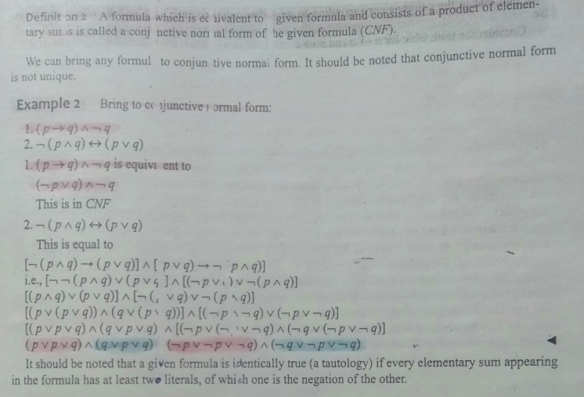

Slide 22
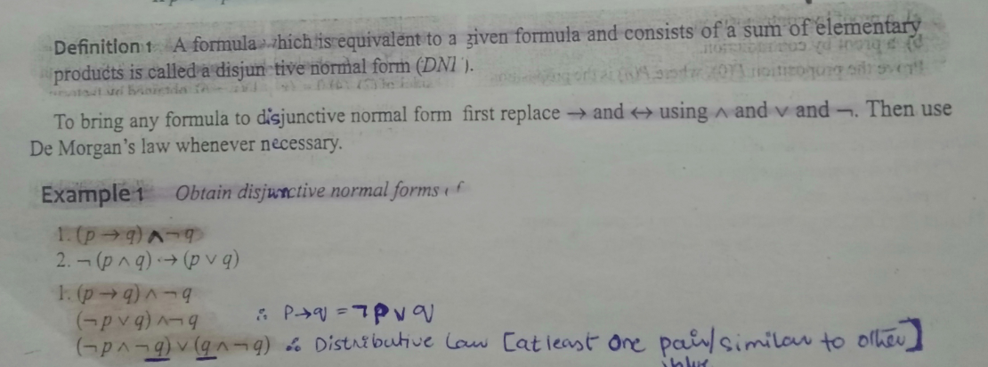

Slide 23
Functionally Complete
A set of logical operators is called functionally complete if every compound proposition is logically equivalent to a compound proposition involving only this set of logical operators.
∧, ∨, and ¬ form a functionally complete set of operators.

Slide 24
Are ¬(p∨(¬p∧q)) and (¬p ∧ ¬q) equivalent?
¬(p∨(¬p∧q))
¬p ∧ ¬(¬p∧q) DeMorgan
¬p ∧ (¬¬p∨¬q) DeMorgan
¬p ∧ (p∨¬q) Double Negation
(¬p ∧ p)∨(¬p ∧¬q) Distribution
(p∧¬p)∨(¬p ∧¬q) ¬P∧P =F(Domination law)
F ∨(¬p ∧¬q) p ∨ q= q ∨ p cummutative
(¬p ∧¬q) ∨ F P ∨ F =p
(¬p ∧¬q) p

Slide 25
Are ¬(p∨(¬p∧q)) and (¬p ∧ ¬q) equivalent?
Even though both are expressed with only ∧, ∨, and ¬, it is still hard to tell without doing a proof.
What we need is a unique representation of a compound proposition that uses ∧, ∨, and ¬.
This unique representation is called the Disjunctive Normal Form.

Slide 26
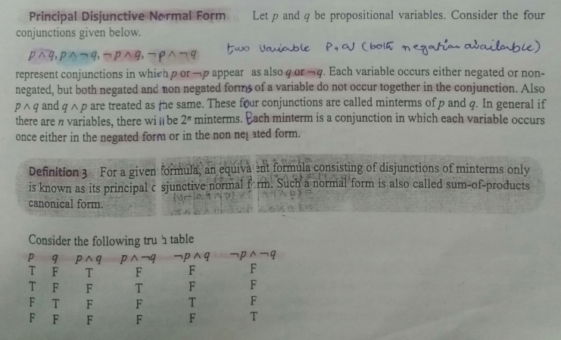

Slide 27
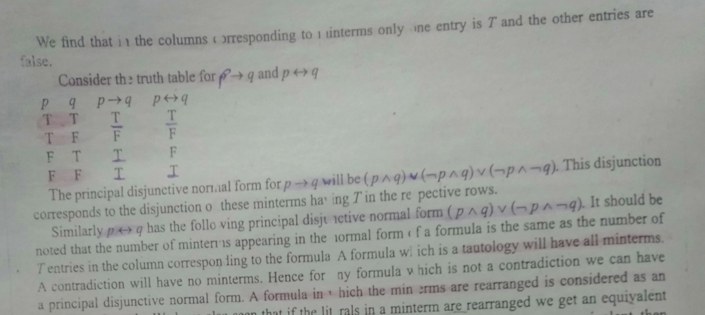

Slide 28
Disjunctive Normal Form
A disjunction of conjunctions where every variable or its negation is represented once in each conjunction (a minterm)
each minterm appears only once
Example: DNF of p⊕q is
(p∧¬q)∨(¬p∧q).

Slide 29
Truth Table
p q p⊕q (p∧¬q) ∨ (¬p∧q)
T T F F
T F T T
F T T T
F F F F

Slide 30
Method to construct DNF
Construct a truth table for the proposition.
Use the rows of the truth table where the proposition is True to construct minterms
If the variable is true, use the propositional variable in the minterm
If a variable is false, use the negation of the variable in the minterm
Connect the minterms with ∨’s.

Slide 31
How to find the DNF of (p ∨ q)→¬r
p q r (p ∨ q) ¬r (p ∨ q)→¬r
T T T T F F
T T F T T T
T F T T F F
T F F T T T
F T T T F F
F T F T T T
F F T F F T
F F F F T T
There are five sets of input that make the statement true. Therefore there are five minterms.

Slide 32
p q r (p ∨ q) ¬r (p ∨ q)→¬r
T T T T F F
T T F T T T
T F T T F F
T F F T T T
F T T T F F
F T F T T T
F F T F F T
F F F F T T
From the truth table we can set up the DNF
(p ∨ q)→¬r = (p∧q∧¬r) ∨ (p∧¬q∧¬r) ∨ (¬p∧q∧¬r) ∨ (¬p∧¬q∧r) ∨ (¬p∧¬q∧¬r)

Slide 33
Resolution

Slide 34
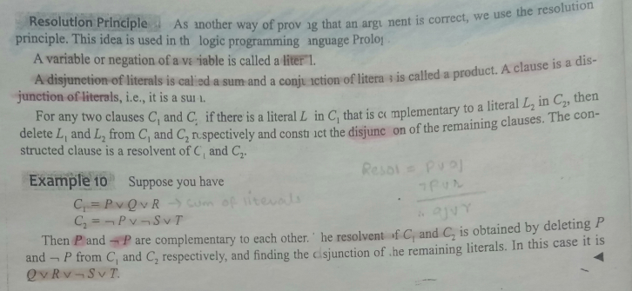

Slide 35
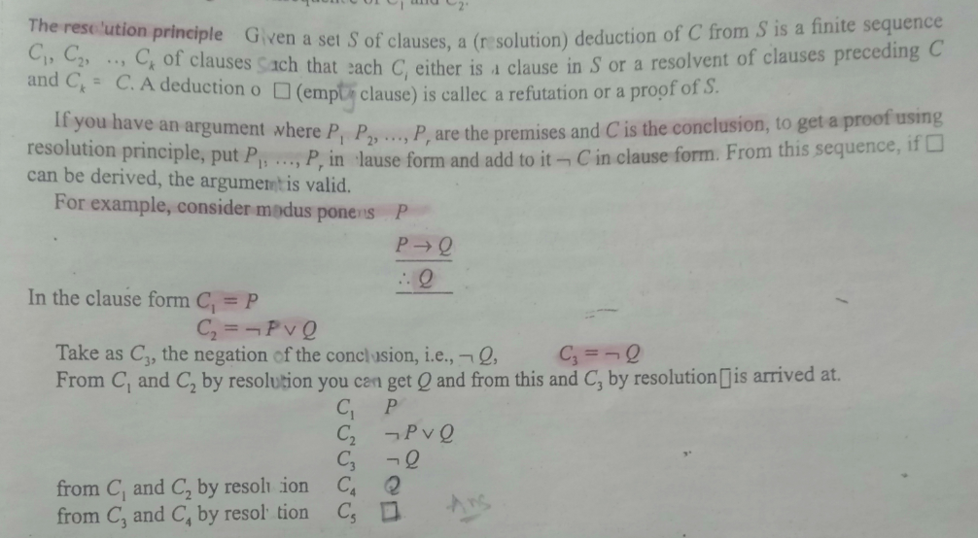

Slide 36
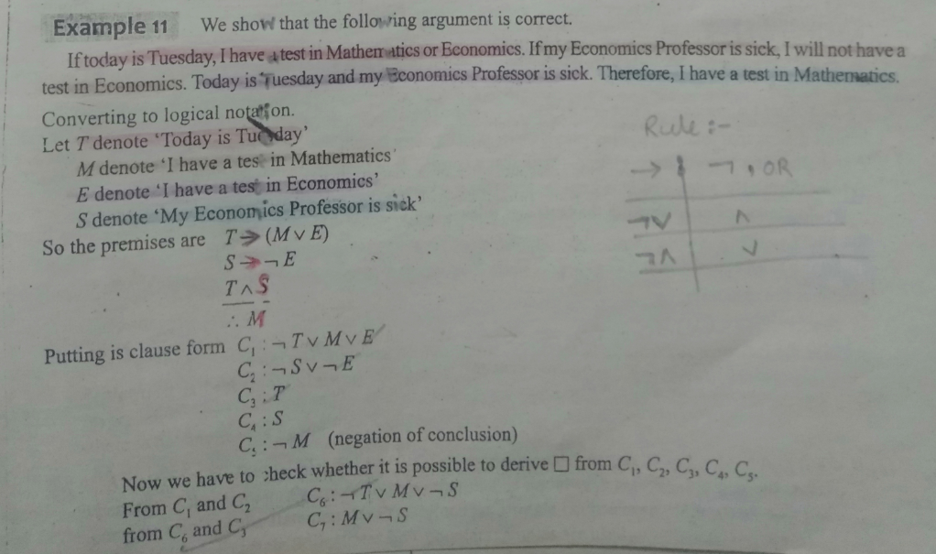
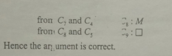

Slide 37
Rules of Inference
For Quantified Statements
Table 2 Rules of Inference for Quantified Statements
Rule of Inference | Name
∀x P(x) ∴ P(c) | Universal Instantiation
P(c) for an arbitrary c ∴ ∀x P(x) | Universal Generalization
∃x P(x) ∴ P(c) for some element c | Existential Instantiation
P(c) for some element c ∴ ∃x P(x) | Existential Generalization

Slide 38
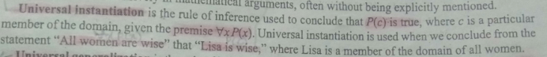
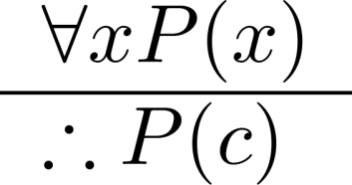
Universal Instantiation (UI)
Example:
Our domain consists of ; “All women are wise”
“Therefore, LISA is wise .
LISA is a member of the domain of all women.

Slide 39
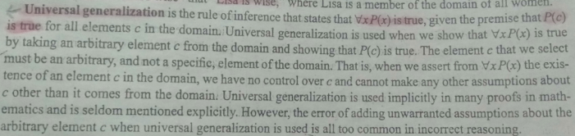
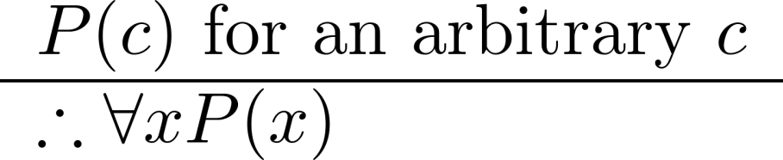
Universal Generalization (UG)
Our domain consists of all boy students are smart and Sachin is a student.
Sachin is smart.”
“Therefore, “All boy students are smart”

Slide 40
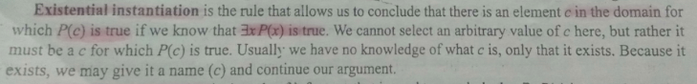
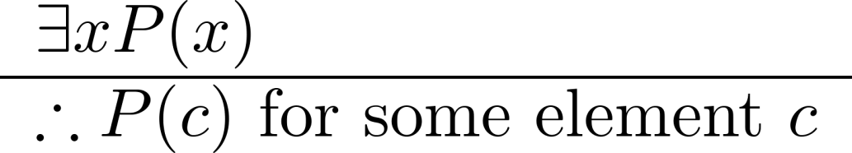
Existential Instantiation (EI)
Example:
“There is someone who got an A in COMPSCI 230.” “Let’s call her Ali and say that Ali got an A”

Slide 41
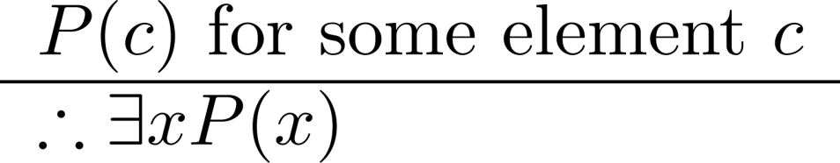
Existential Generalization (EG)
Example:
“Ali got an A in the class.”
“Therefore, someone got an A in the class.”

Slide 42
Example
Show that the premises
“Everyone in this discrete mathematics class has taken a course in computer science” .
“Marla is a student in this class”
imply the conclusion “Marla has taken a course in computer science.”

Slide 43
Solution
Let D(x) denote “x is in this discrete mathematics class,”
and let C(x) denote “x has taken a course in computer science.”
“Everyone in this discrete mathematics class has taken a course in computer science”

Slide 44
Solution
Let D(x) denote “x is in this discrete mathematics class,”
and let C(x) denote “x has taken a course in computer science.”
“Everyone in this discrete mathematics class has taken a course in computer science”
∀x(D(x) → C(x))

Slide 45
Solution
Let D(x) denote “x is in this discrete mathematics class,”
and let C(x) denote “x has taken a course in computer science.”
“Marla is a student in this class”
D(Marla)

Slide 46
Solution
Let D(x) denote “x is in this discrete mathematics class,”
and let C(x) denote “x has taken a course in computer science.”
“Marla has taken a course in computer science.”
C(Marla)

Slide 47
Solution
Premises:
∀x(D(x) → C(x)) D(Marla)
Conclusion: C(Marla)

Slide 48
Solution
The following steps can be used to establish the conclusion from the premises.
Step Reason
1. ∀x(D(x) → C(x))
Premise

Slide 49
Solution
The following steps can be used to establish the conclusion from the premises.
Step Reason
1 ∀x(D(x) → C(x))
2. D(Marla) → C(Marla)
Premise
Universal instantiation from (1)

Slide 50
Solution
The following steps can be used to establish the conclusion from the premises.
Step Reason
1. ∀x(D(x) → C(x))
D(Marla) → C(Marla)
D(Marla)
Premise
Universal instantiation from (1) Premise

Slide 51
Solution
The following steps can be used to establish the conclusion from the premises.
Step Reason
1. ∀x(D(x) → C(x))
D(Marla) → C(Marla)
D(Marla)
Premise
Universal instantiation from (1) Premise
You can use other rules of inference!

Slide 52
Solution
The following steps can be used to establish the conclusion from the premises.
Step Reason
1. ∀x(D(x) → C(x))
D(Marla) → C(Marla)
D(Marla)
C(Marla)
Premise
Universal instantiation from (1) Premise
Modus ponens from (2) and (3)

Slide 53
Combining Rules of Inference for Propositions and Quantified Statements

Slide 54
Universal Modus Ponens
∀x(P(x) → Q(x))
P(a), where a is a particular element in the domain
∴ Q(a)
Universal Modus Tollens
∀x(P(x) → Q(x))
¬Q(a), where a is a particular element in the domain
∴ ¬P(a)

